Slide 1
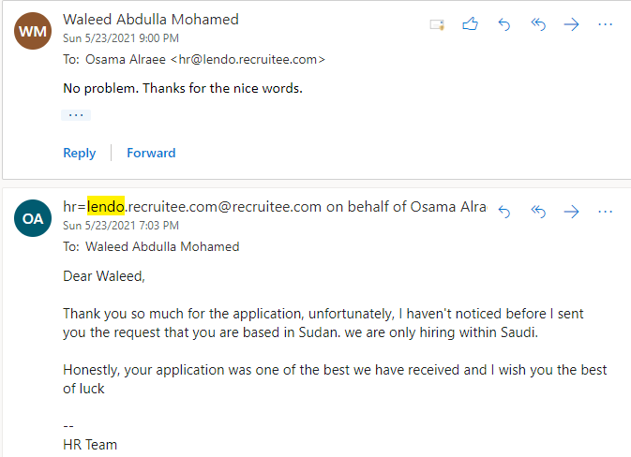

Slide 2


Slide 3
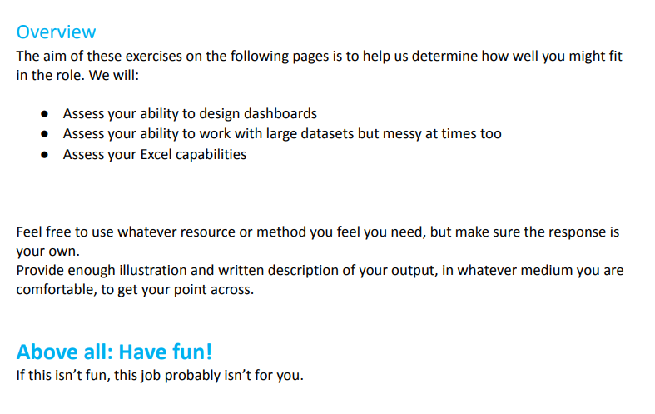

Slide 4
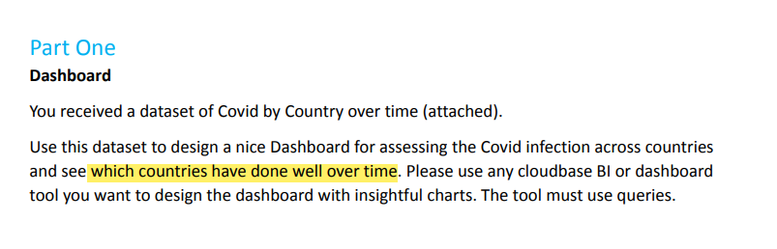

Slide 6
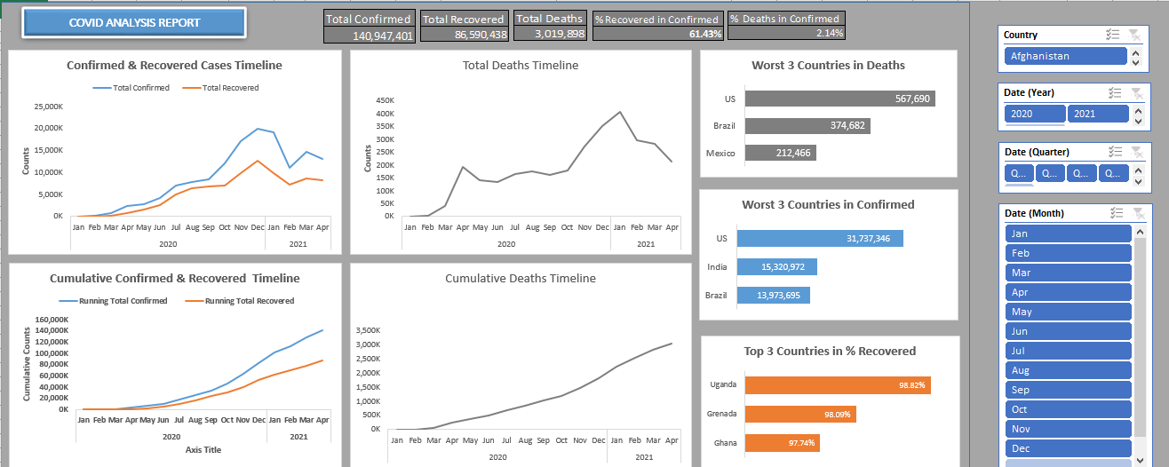

Slide 7
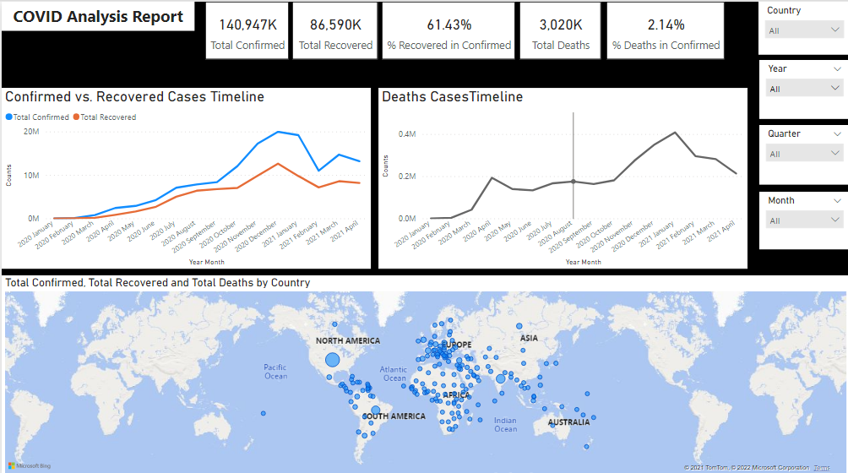

Slide 8
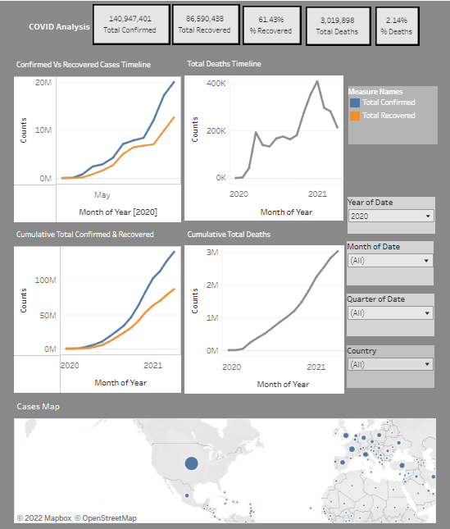

Slide 9
COVID Pandemic Analysis
Condolences to the good people who lost their family members or friends in this pandemic

Slide 10
Agenda
Introduction.
Data Quality.
Data Cleansing.
Analysis:
General Figures.
Development of the Pandemic.
Worst 3 Countries in Confirmed Cases.
Worst 3 Countries in Deaths Cases.
Top 3 Countries in Percent Recovered.
Insights and Lessons.

Slide 11
INTRODUCTION
The dataset shows the records of daily COVID-pandemic cases worldwide.
The data consist of 5 columns for Date, Country, Confirmed, Recovered & Deaths cases.
The total number of records is more than 82,000, and the timeline extend from January 22 2020 till April 19 2021.

Slide 12
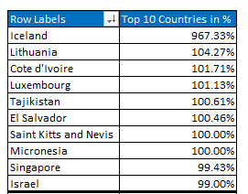
Data Quality
Some countries show more recovered cases than confirmed.
Other countries showed very high recovered percentage (99% or more).
To avoid dealing with outliers, those countries are deleted from the data.

Slide 13
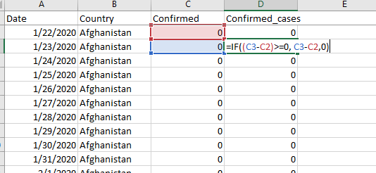
Data Cleaning
The original dataset showed the accumulated total numbers of cases. Therefore, new columns are added to show only the daily number of cases which helps in calculations.

Slide 14
Analysis

Slide 15
General Figures
After Excluding the outliers, below are the general figures of the dataset.
Measure Name | Value
Total Confirmed Cases | 140,947,401
Total Recovered Cases | 86,590,438
Total Deaths | 3,019,898
% Recovered in Confirmed | 61.43%
% Deaths in Confirmed | 2.14%

Slide 16
Development of Pandemic
The recording of cases started in January 2020 with a total confirmed and recovered of 9,357 and 195 cases respectively worldwide.
Reached a monthly total of 19,960,109 and 12,612,710 respectively in December 2020.
Both figures declined to reach monthly totals of 13, 174,060 and 8,162,038 respectively.

Slide 17
Development of Pandemic
Same trend can be seen in the number of total Deaths.
The monthly total number of total in January 2020 was 196.
Increased constantly to reach a peak of 408,170 in January 2021.
Declined steadily to reach a monthly total of 213,358 in April 2121.

Slide 18
Worst 3 Countries in Confirmed Cases

Slide 19
Worst 3 Countries in Deaths Case

Slide 20
Top 3 Countries in % Recovered

Slide 21
Insights & Conclusion
The number of cases started small, however, it developed fast.
That can be due to the lack of formal effective preventative measures or because of the lack of public awareness.
Countries with small flux of people like the African nations had small number of cases.
Small number of cases means no pressure on the healthcare system.
No pressure of the healthcare system resulted in better % Recovered in Confirmed.

